Slide 1
Analysis of World Football Transfers in the 2021 Calendar Year
Christopher Spann

Slide 2
Background
McDaniel College – Master’s of Data Analytics
Fundamentals of Python Programming – Data Analytics Project
Purpose: Choose a dataset of interest and establish research findings and conclusions
Data Prep/Cleaning
Data Munging
Data Visualization
Data Aggregation and Grouping

Slide 3
Introduction to Project and Data
Goal: To better summarize statistics of football transfers that occurred in the 2021 calendar year using data cleaning, transformation, organization, and visualization techniques in Python
Focus on permanent transfers between two clubs with a fee greater than 0.
Attributes of interest
Club Destination
Player Position
Player Age
Dataset - Football Transfers 2021 (Kaggle)
Scraped from transfermarkt site
65,489 records
11 variables

Slide 4
Data Cleaning & Preparation
Removed all records in which the player retired, went without club, took a career break, was banned, or destination is unknown
Created a clean transfer fee column by removing text, symbols, etc. and utilizing the unit (millions or thousands)
Updated clean transfer fee value to 0 for records not applicable to research scope
Removed all records in which transfer fee = 0 or equivalent
Loans, Drafts, Free Transfers, Null Values
Final Dataset: 1,914 records

Slide 5
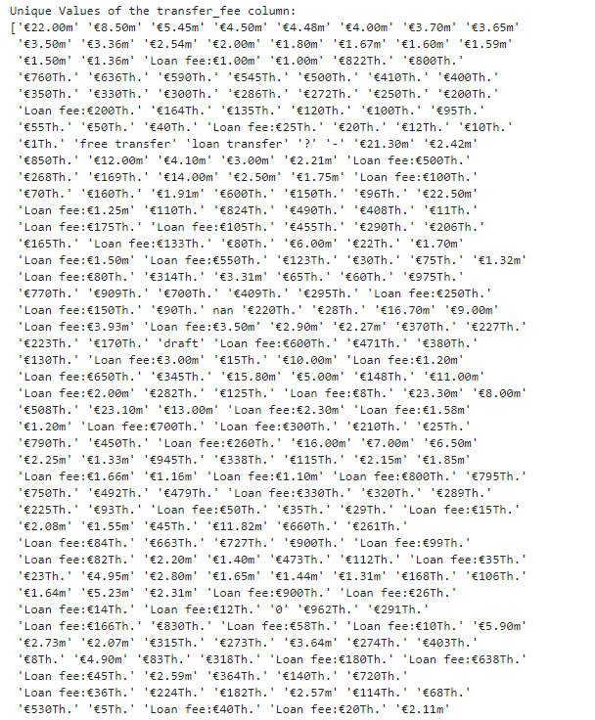
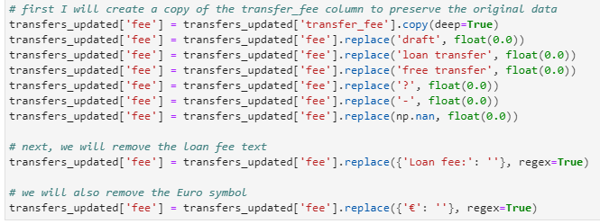
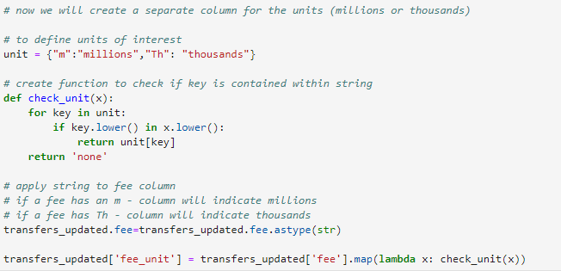
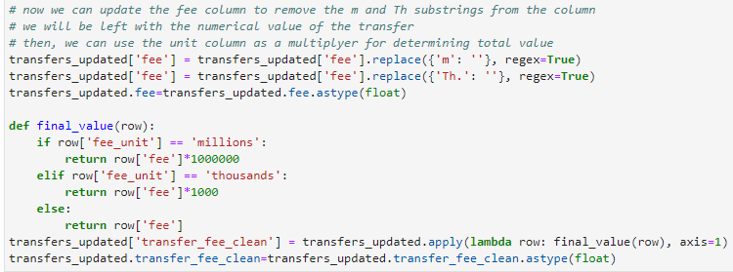

Slide 6
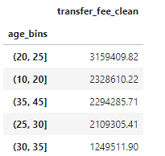
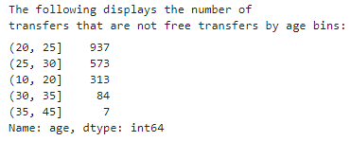
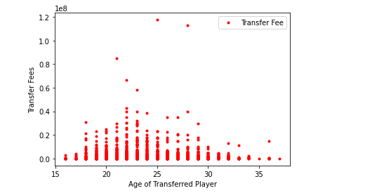
Age Analysis
Players between 22 and 28 generally have higher values than those below or above in age
Most transfers occurred for players aged 21-25
Scatterplot helps show distribution of transfer fees by age which helps identify outliers

Slide 7
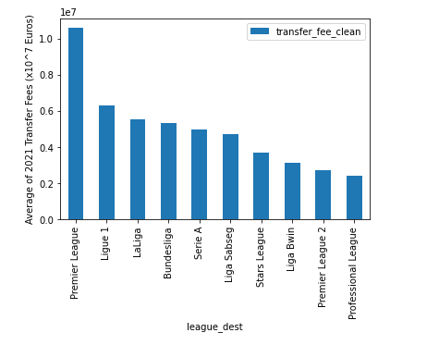
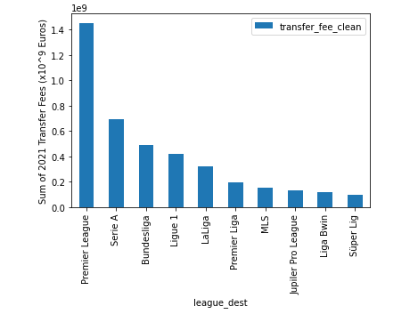
Destination League Analysis
Avg Transfer Value by League (Top 10)
Total 2021 Transfer Value by League (Top10)

Slide 8
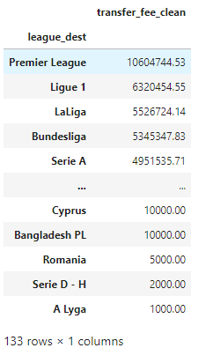
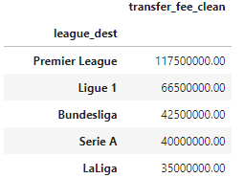
Destination League Analysis
Avg Transfer Value by League (Top/Bottom 5)
Max Transfer Value by League (Top 5)
Text goes here

Slide 9
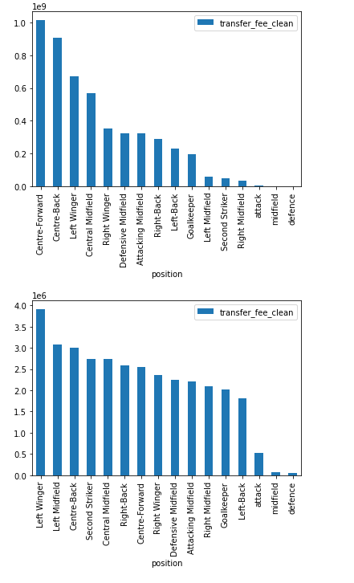
Position Analysis
Total Spending by Position
1,000,000,000 euros spent on center forwards!
Center forwards had the highest total spend as a position group, but the highest average transfer fee was tied to left wingers
Avg Transfer Value by Position

